Slide 1

SCILAB
Bessel Function
Legendre Function
Presentation by:- Diya, Ritika and Chirag

Slide 2

INTRODUCTION
Scilab is the open source, user friendly and computational package that is used in various streams of science and engineering. Scilab helps us to perform operations like matrix operations, simulation, plotting, etc. Many numerical problems can be expressed in a reduced number of code lines, as compared to similar solutions using traditional languages. We can install Scilab from websites:-
www.scilab.org
www.scilab.in

Slide 3
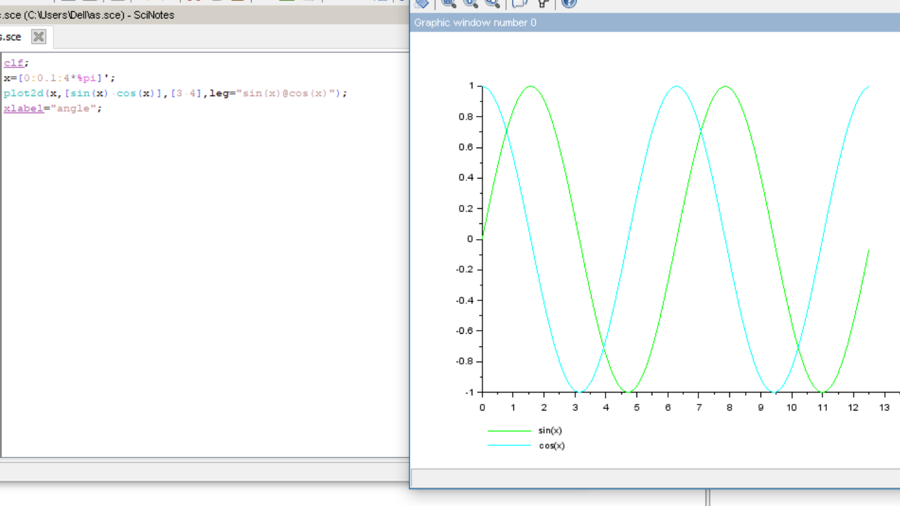
PLOTTING

Slide 4
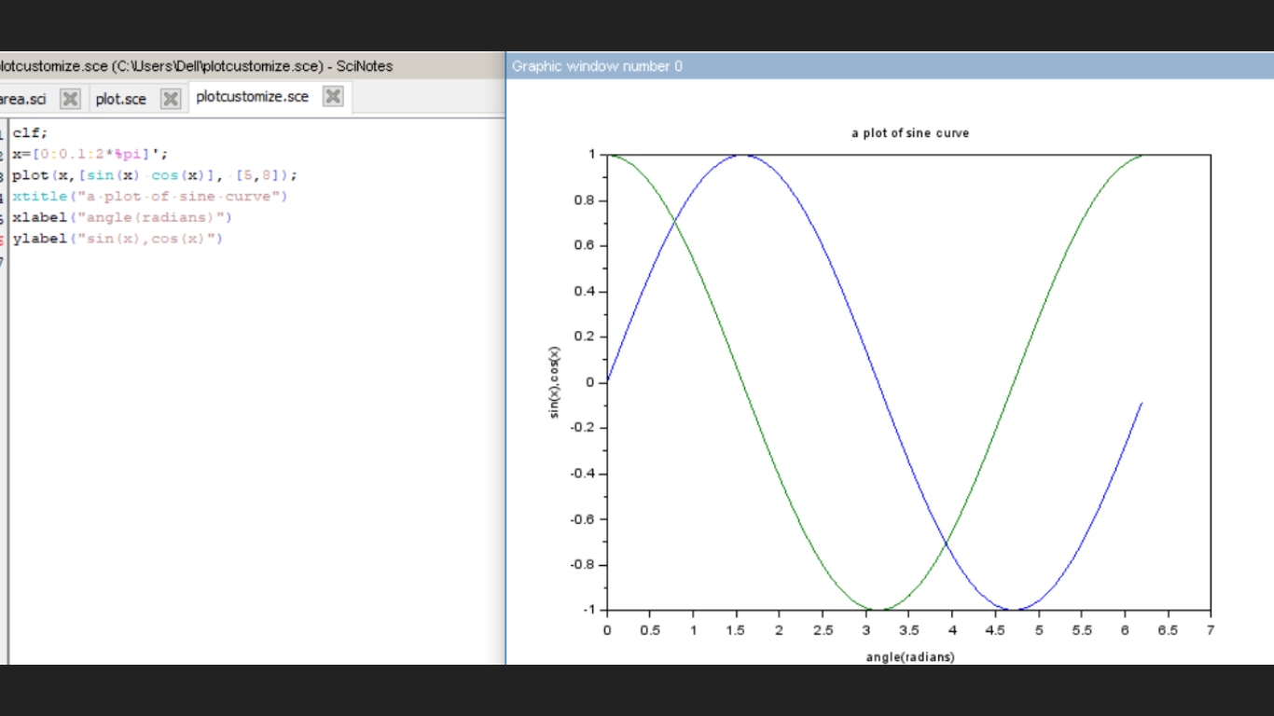

Slide 5
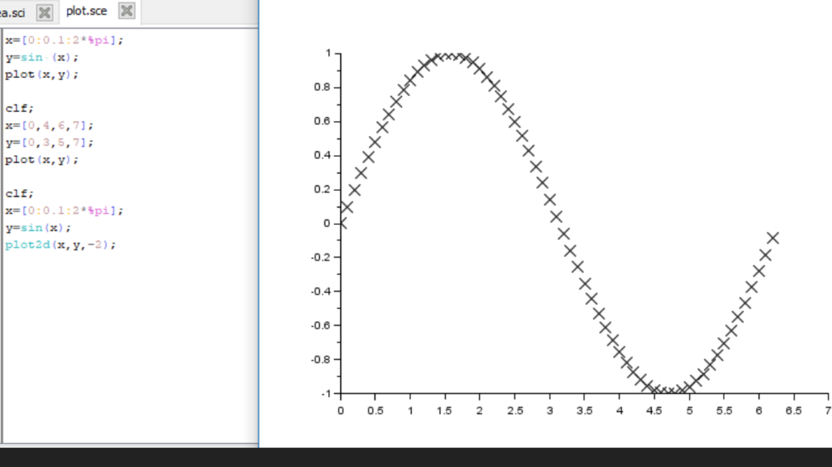

Slide 6

BESSEL FUNCTION
Bessel functions are also known as cylindrical functions-
for an arbitrary complex number α, the order of the Bessel function. Although α and −α produce the same differential equation for real α, it is conventional to define different Bessel functions for these two values in such a way that the Bessel functions are mostly smooth functions of α.

Slide 7

Bessel function is also known as first and second order kind. The above equation is second order Bessel differential equation, therefore, there must be two linearly independent solutions.
There are two types of Bessel functions –
Bessel function of first kind, J_{α}
Bessel function of second kind, Y_{α}
Bessel function of first kind-
Bessel functions of the first kind, denoted as J_{α}(x), are solutions of Bessel's differential equation that are finite at the origin (x = 0) for integer or positive α and diverge as x approaches zero for negative non-integer α. It is possible to define the function by its series expansion around x = 0, which can be found by applying the Frobenius method to Bessel's equation:

Slide 8
where Γ(z) is the gamma function, a shifted generalization of the factorial function to non-integer values. The Bessel function of the first kind is an entire function if α is an integer, otherwise it is a multivalued function with singularity at zero. The graphs of Bessel functions look roughly like oscillating sine or cosine functions that decay proportionally to ​¹⁄_{√x} , although their roots are not generally periodic, except asymptotically for large x.

Slide 9
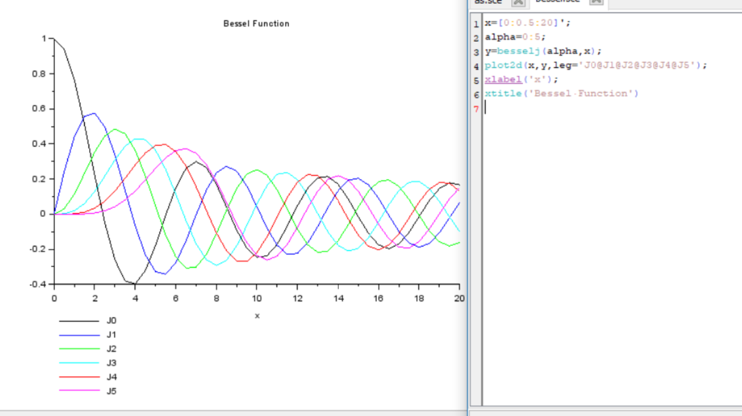
BESSEL FUNCTION IN SCILAB

Slide 10
APPLICATIONS OF BESSEL FUNCTION
Electromagnetic waves in a cylindrical waveguide
Heat conduction in a cylindrical object
Modes of vibration of a thin circular (or annular) acoustic membrane (such as a drum)
Solutions to the radial Schrödinger equation (in spherical and cylindrical coordinates) for a free particle
Dynamics of floating bodies

Slide 11
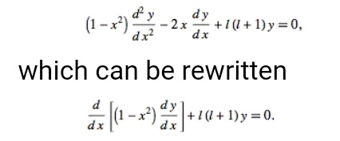
LEGENDRE FUNCTION
In mathematics, Legendre functions are the solution of Legendre differential equation-

Slide 12

The above form is Legendre differential equation corresponding to the case m=0. The Legendre differential equation has regular singular points at -1, 1, and infinity .
If the variable is replaced by cos theta , then the Legendre differential equation becomes
derived below is the case when m is not equal to 0

Slide 13
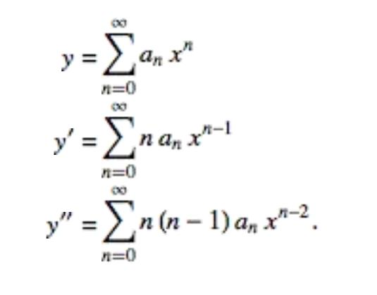
Since the Legendre differential equation is a second-order ordinary differential equation, it has two linearly independent solutions. A solution p1(x) which is regular at finite points is called a Legendre function of the first kind, while a solution Q1(x) which is singular at +1 & -1 is called a Legendre function of the second kind. If l is an integer, the function of the first kind reduces to a polynomial known as the Legendre polynomial.
The Legendre differential equation can be solved using the Frobenius method by making a series expansion with k=0,
Plugging in, the orignal equation

Slide 14
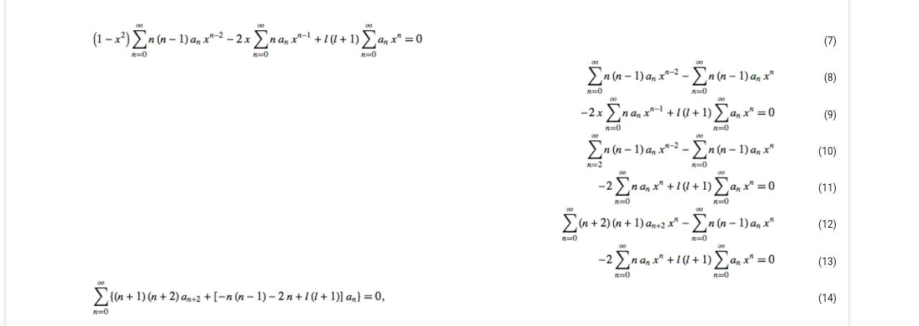
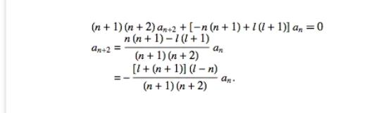
Each term should vanish_

Slide 15
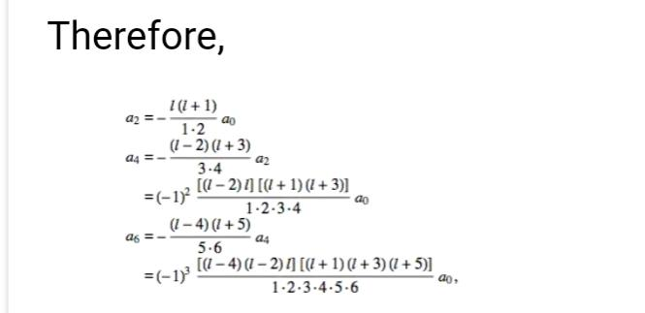
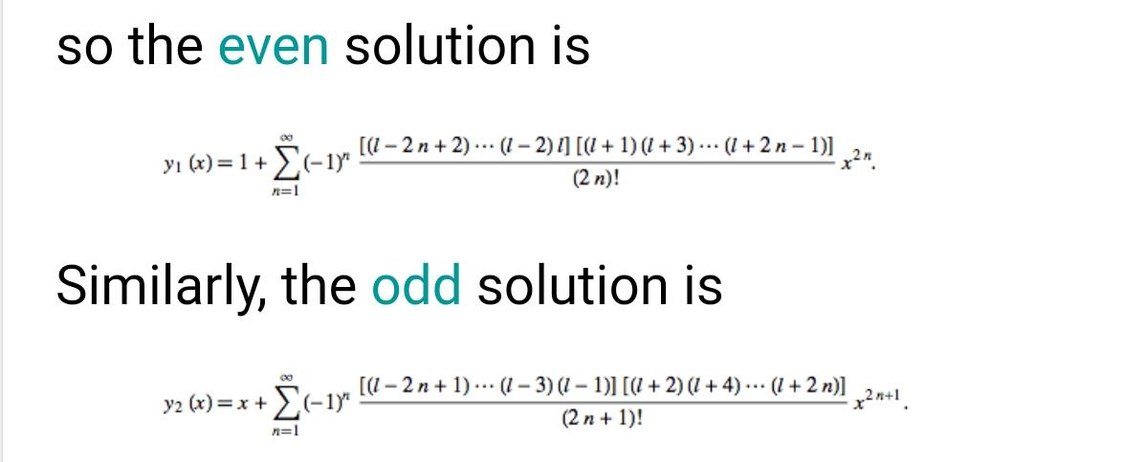
If l is an even integer, the series y1(x) reduces to a polynomialof degree l with only even powers of x and the series diverges. If l is an odd integer, the series y2(x) reduces to a polynomial of degree l with only odd powers of x and the series y1(x) diverges.

Slide 16
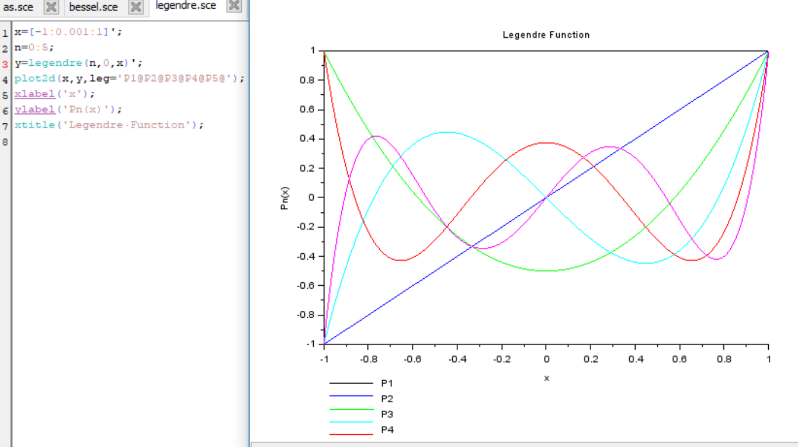
LEGENDRE FUNCTION IN SCILAB

Slide 17


APPLICATIONS OF LEGENDRE FUNCTION
1)Expanding a 1/r² potential
2)Legendre polynomials in multipole expansions
Legendre polynomials are also useful in expanding functions of the form:
3)Legendre polynomials in trigonometry
The trigonometric functions cos nθ, also denoted as the Chebyshev polynomials T_{n}(cos θ)≡cos nθ, can also be multipole expanded by the Legendre polynomials P_{n}(cos θ).
4) Legendre Function do not have direct application in physics, It is a mathematical tool that is required to solve numerical problems in physics.

Slide 18
ACKNOWLEDGEMENT
We would like to express our special thanks of gratitude to our teacher Mr. Lokesh Kumar as well as other teachers who gave us the golden opportunity to do this wonderful project on the topic Bessel function and Legendre function in Scilab, which also helped us in doing a lot of research and we came to know many new things. Secondly, we would also like to thank our friends who helped us a lot in finalising this project within the limited time frame.

Slide 19


